Slide 1
ICM-42688-P 32K/8K/4KHz DRDY read vs arbitrary CLK
ICM-45688 8K/6.4KHz DRDY read vs arbitrary CLK
Aug, 2025
InvenSense, Inc.
A TDK Group Company
MEMS Sensors Business Group
Sensor Systems Business Company
]
[2025-08-22]

Slide 2
Summary
Synchronous IMU data polling minimizes processed VIN amplitude (for a monotonic sinusoidal injection)
For Asynchronous IMU data polling, the processed VIN amplitude decreases as the ODR of the IMU increases (for a monotonic sinusoidal injection)
Test Condition → Monotonic sinusoidal electrical signal injection to the ADC input.
  Process IMU AZ sensor register raw data with 30Hz LPF followed by a 16K-sample moving average LPF
Offset variation Peak-to-Peak (mgee) | ICM-45688 6.4KHz ODR | ICM-45688 8KHz ODR
Synchronous Polling | 1 | 1
Asynchronous Polling | 19 | 13
Offset variation Peak-to-Peak (mgee) | ICM-42688-P 4KHz ODR | ICM-42688-P 8KHz ODR | ICM-42688-P 32KHz ODR
Synchronous Polling | 1 | 1 | 2
Asynchronous Polling | 19 | 13 | 8

Slide 3
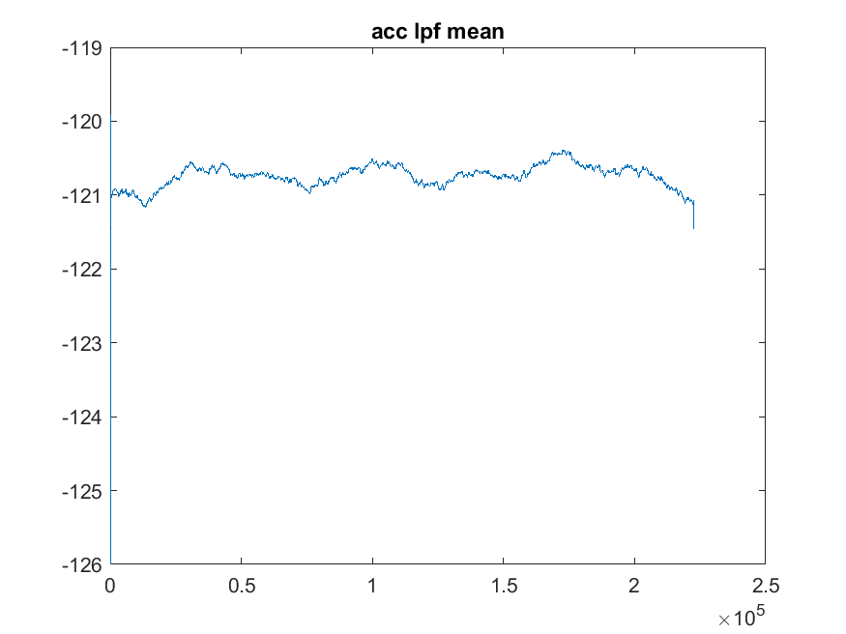
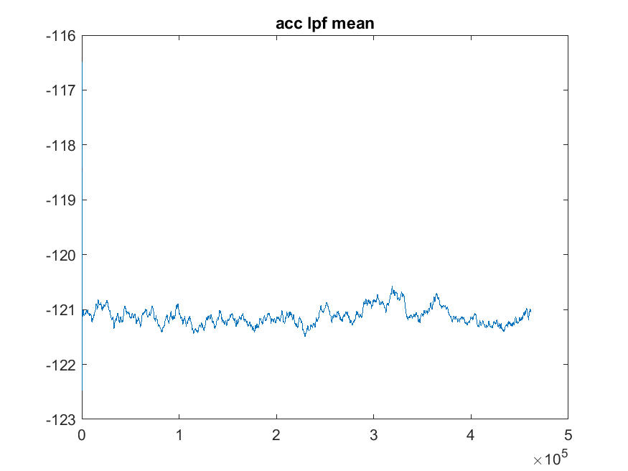
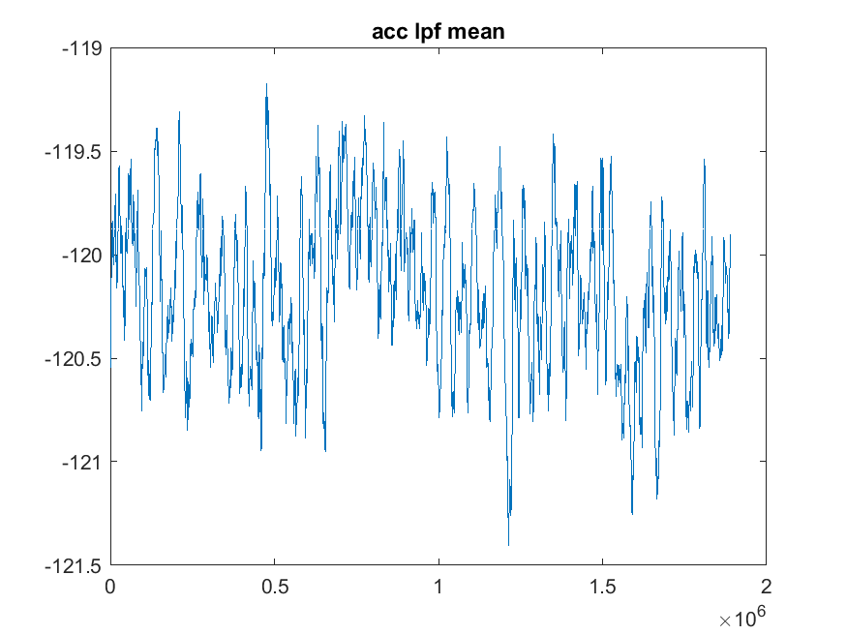
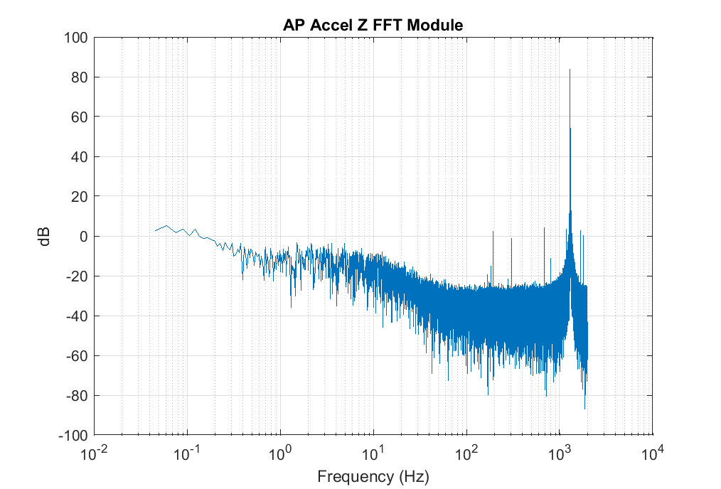
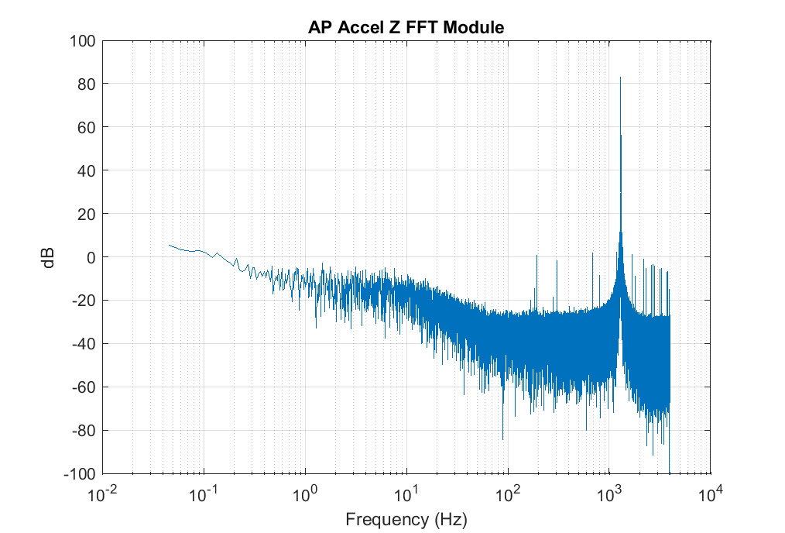
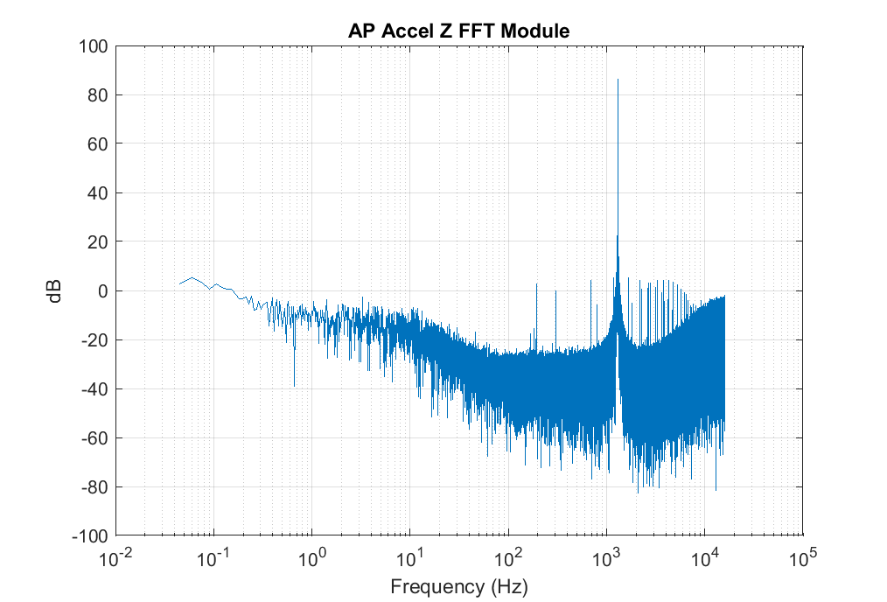
ICM- 42688-P Synchronous Polling at 1.3KHz (DRDY INT)
mgee
Post 30Hz LPF + 16K-sample Moving Average LFP
1 milli-gee
1 milli-gee
2 milli-gee
time
FFT of IMU raw data
Fs = 4Ksps
Fs = 8Ksps
Fs = 32Ksps

Slide 4
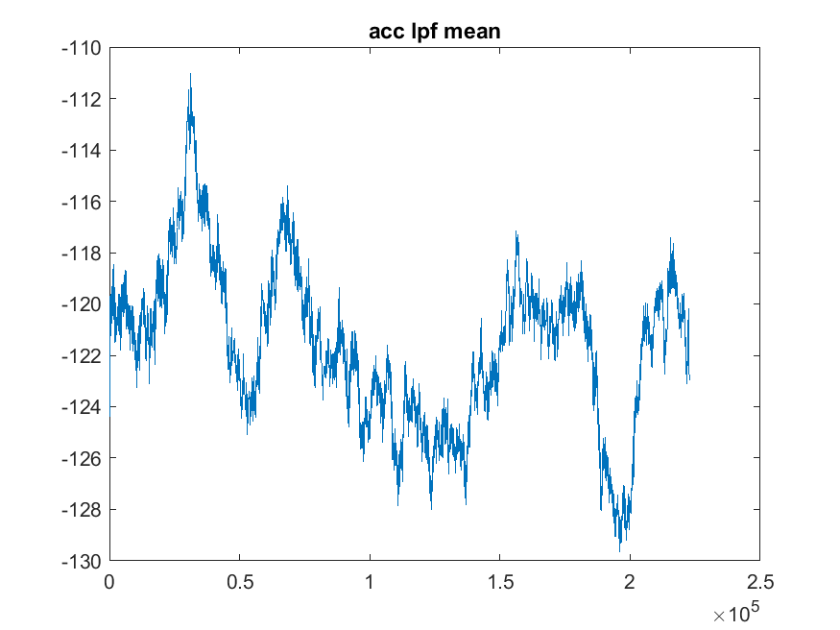
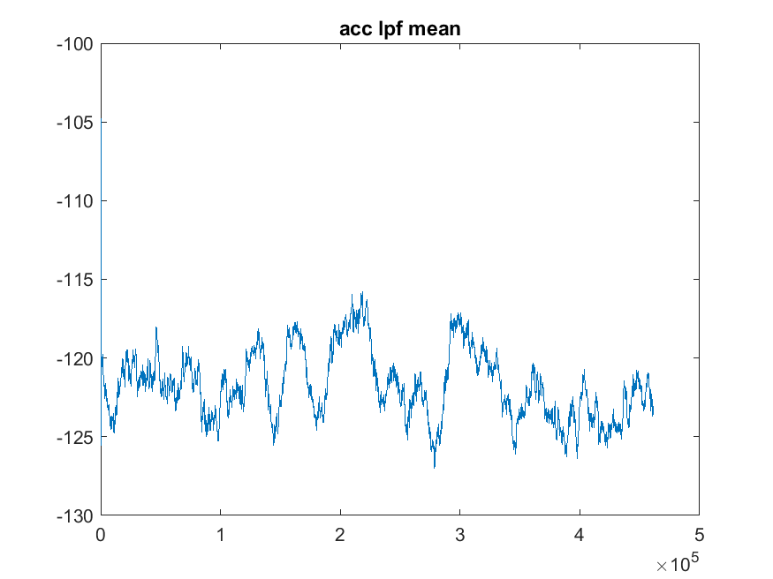
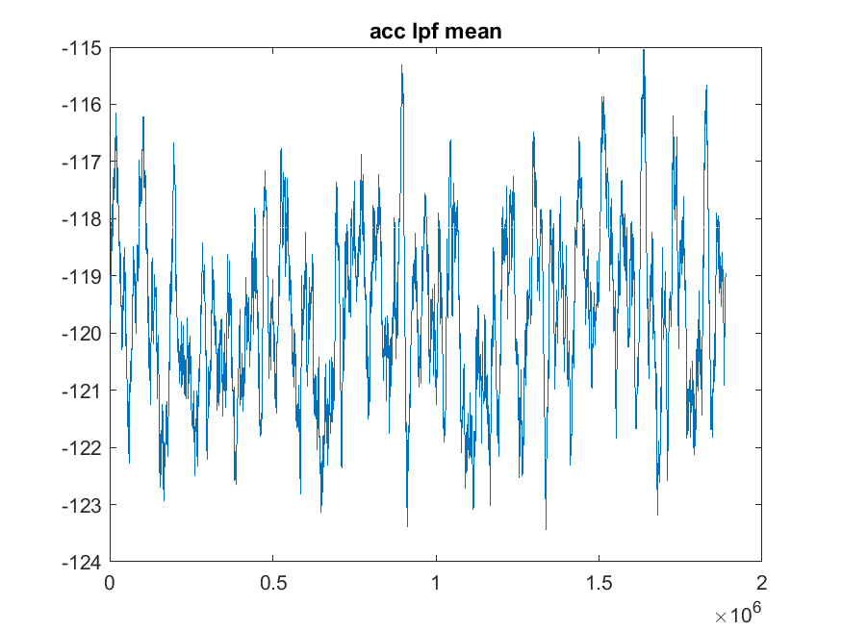
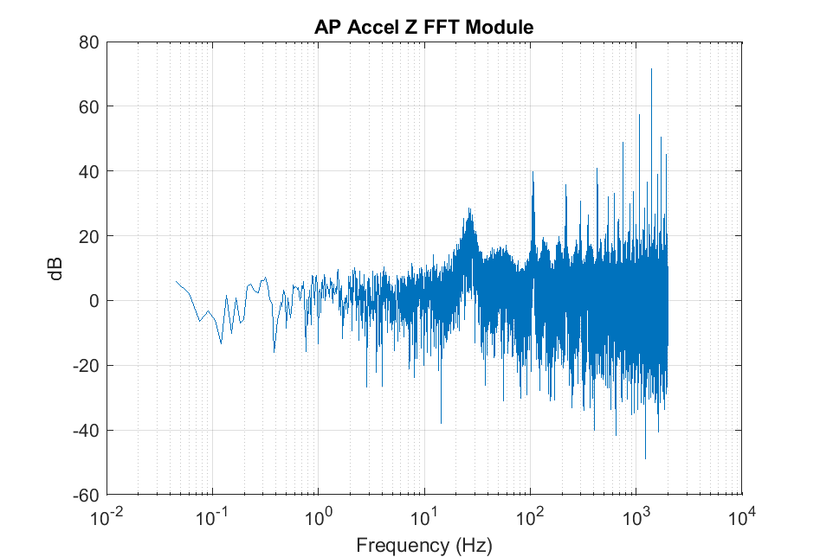
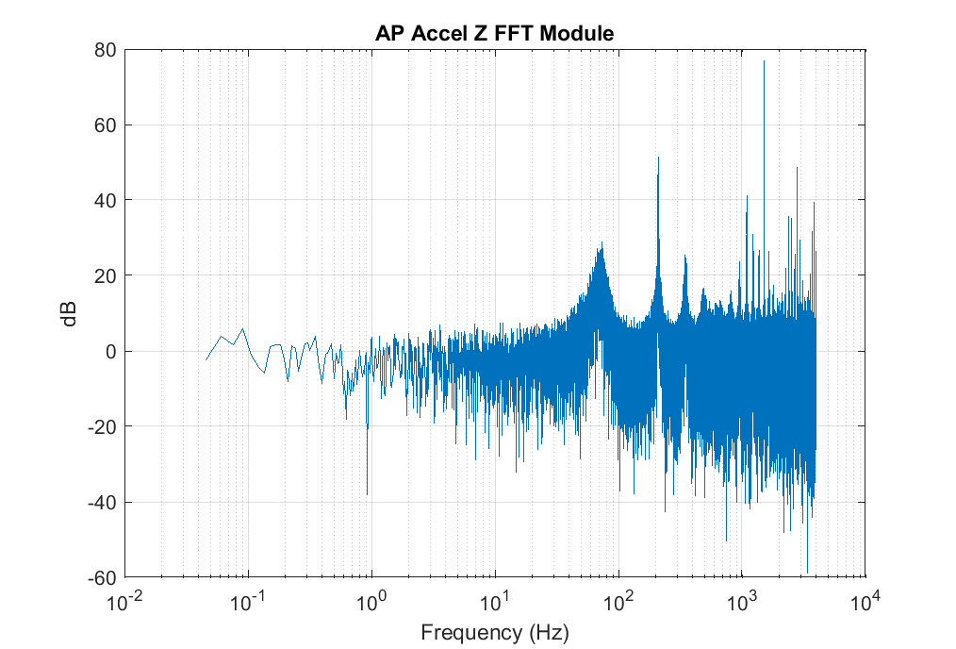
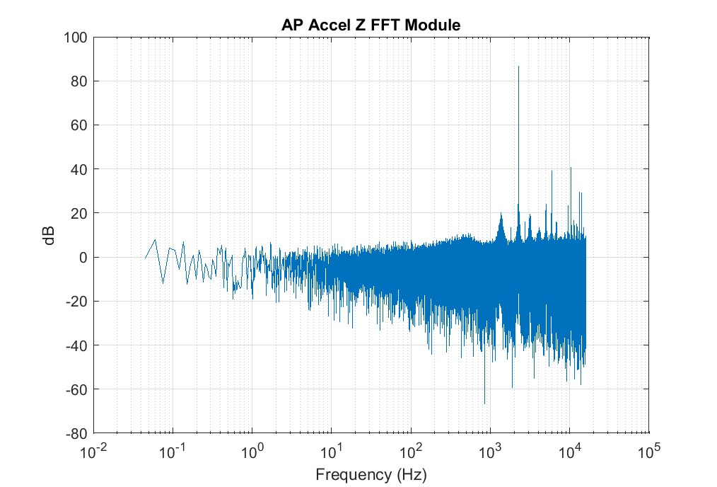
ICM-42688-P - Asynchronous Polling at 1.3KHz
mgee
Post 30Hz LPF + 16K-sample Moving Average LFP
8 milli-gee
19 milli-gee
13 milli-gee
time
FFT of IMU raw data
Spurs
Spurs
Spurs
Fs = 3.977Ksps
Fs = 7.956Ksps
Fs = 31.826Ksps

Slide 5
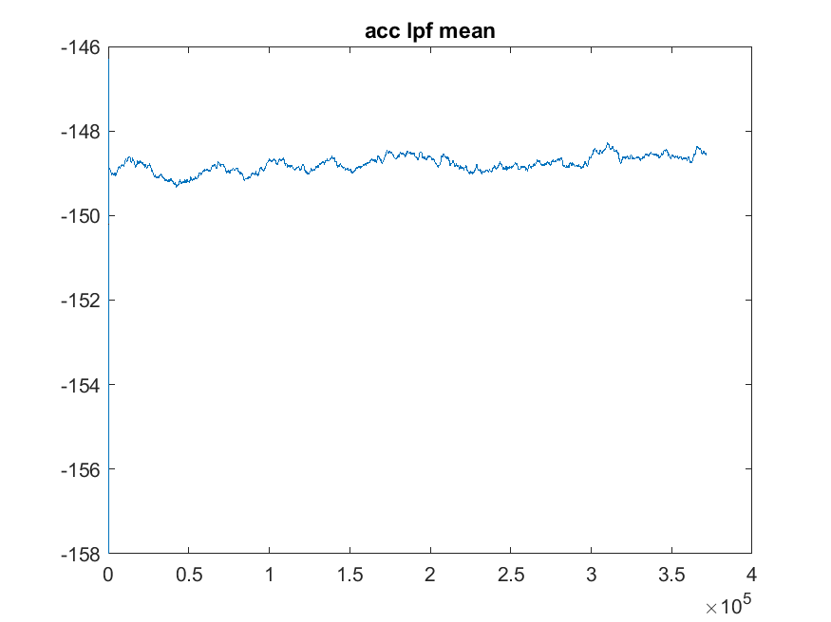
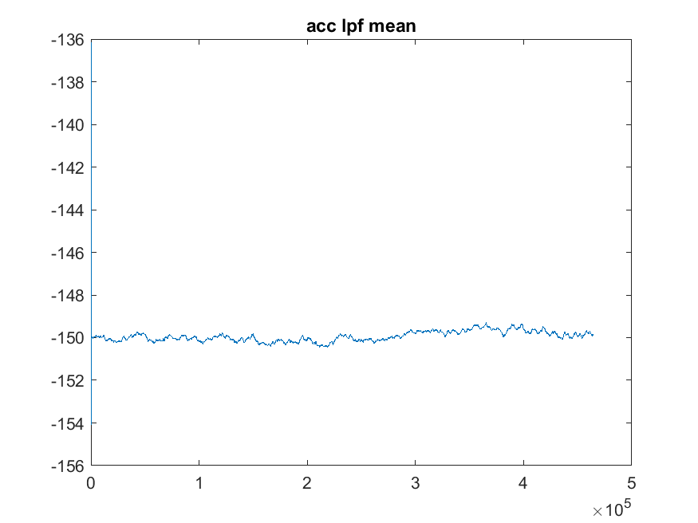
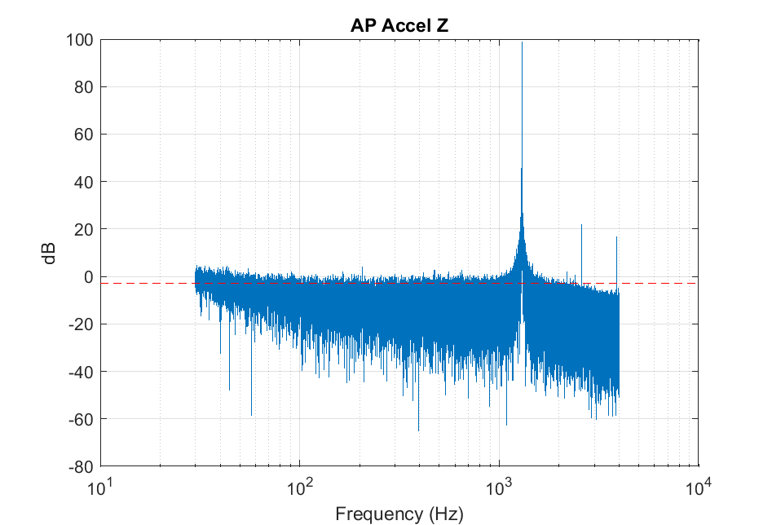
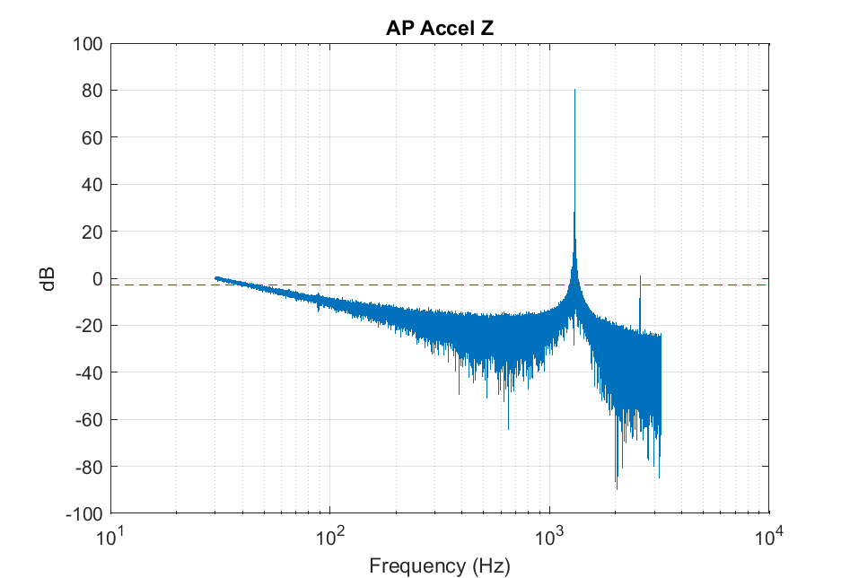
ICM- 45688 Synchronous Polling at 1.3KHz (DRDY INT)
mgee
Post 30Hz LPF + 16K-sample Moving Average LFP
1 milli-gee
1 milli-gee
time
FFT of IMU raw data
Fs = 6.455Ksps
Fs = 8.004Ksps

Slide 6
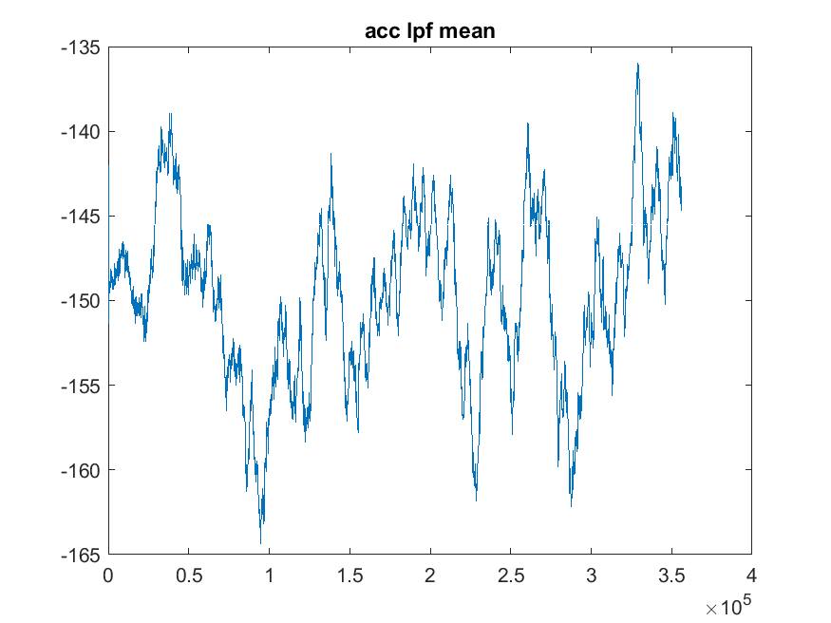
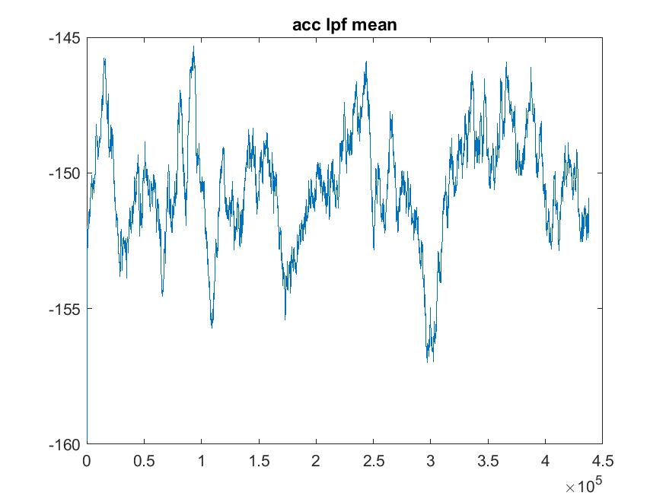
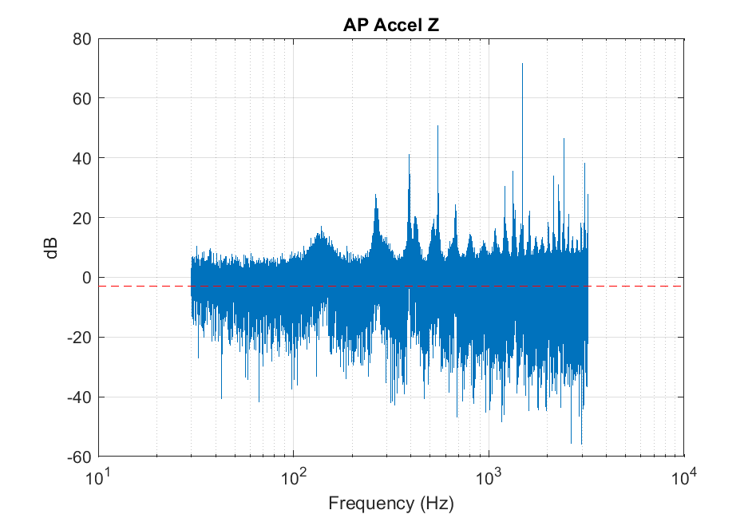
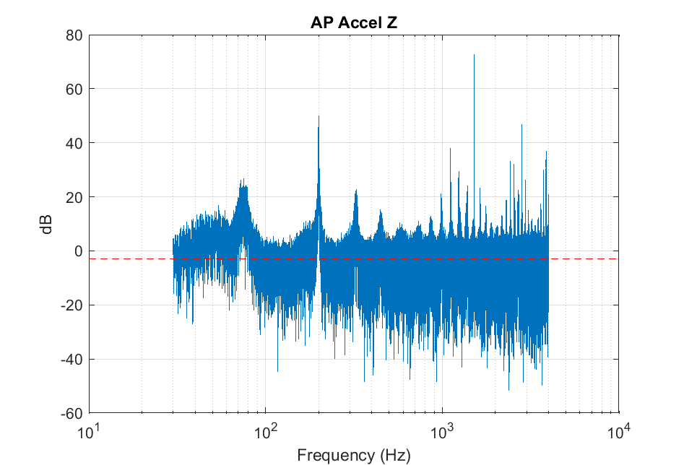
ICM-45688 - Asynchronous Polling at 1.3KHz
mgee
Post 30Hz LPF + 16K-sample Moving Average LFP
19 milli-gee
13 milli-gee
time
FFT of IMU raw data
Spurs
Spurs
Fs = 6.457Ksps
Fs = 8.006Ksps

